Slide 1
Python - Introduction

Slide 2
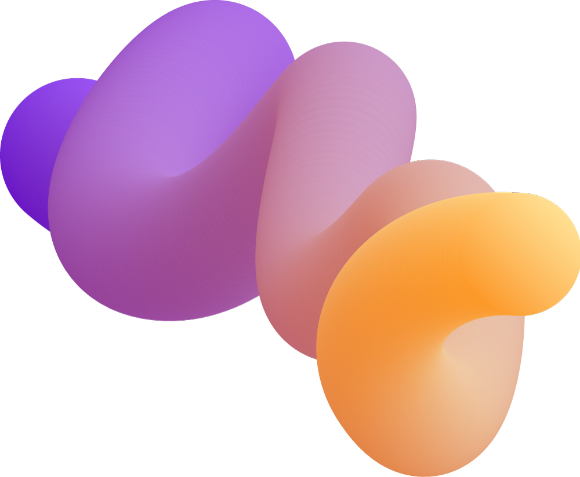
Table of contents
01
03
04
What is Python ?
Why Python ?
02
History of Python
Evolution of Python
Applications of Python
05

Slide 3
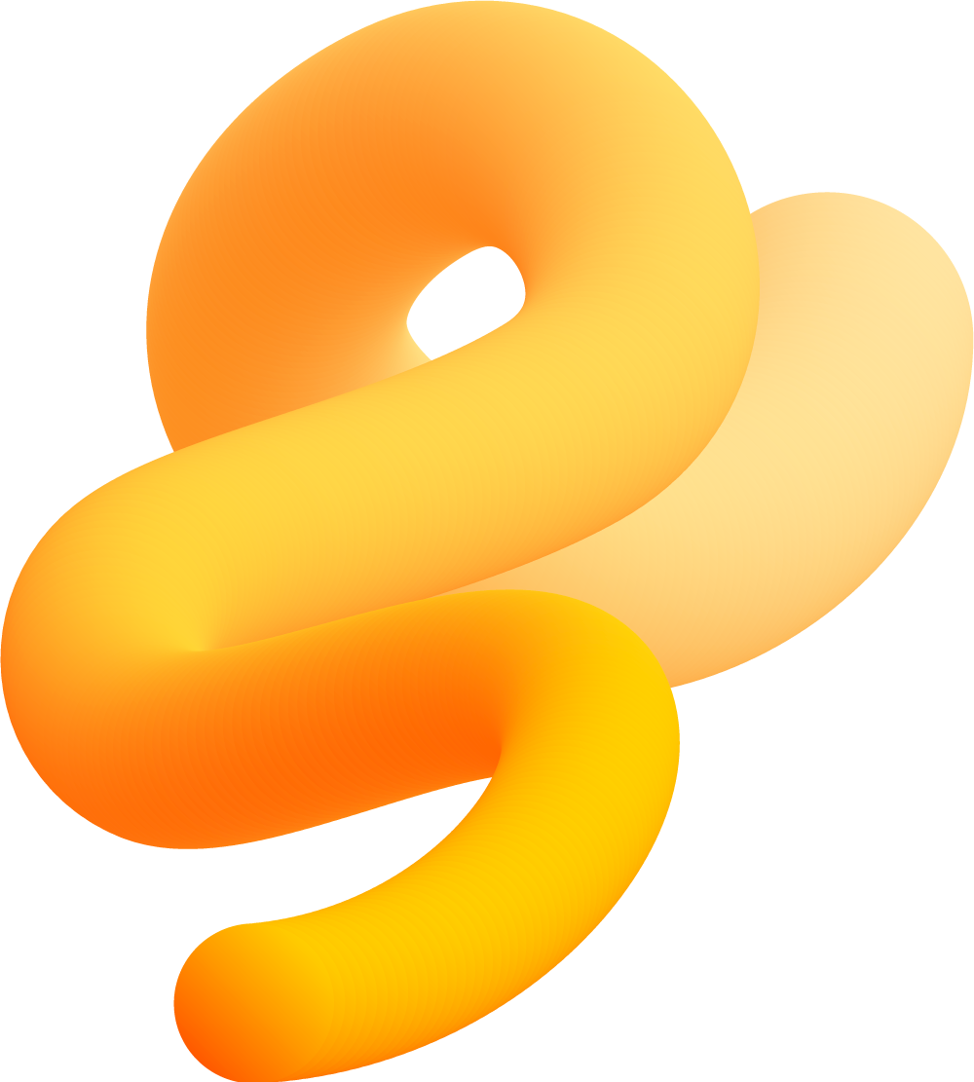
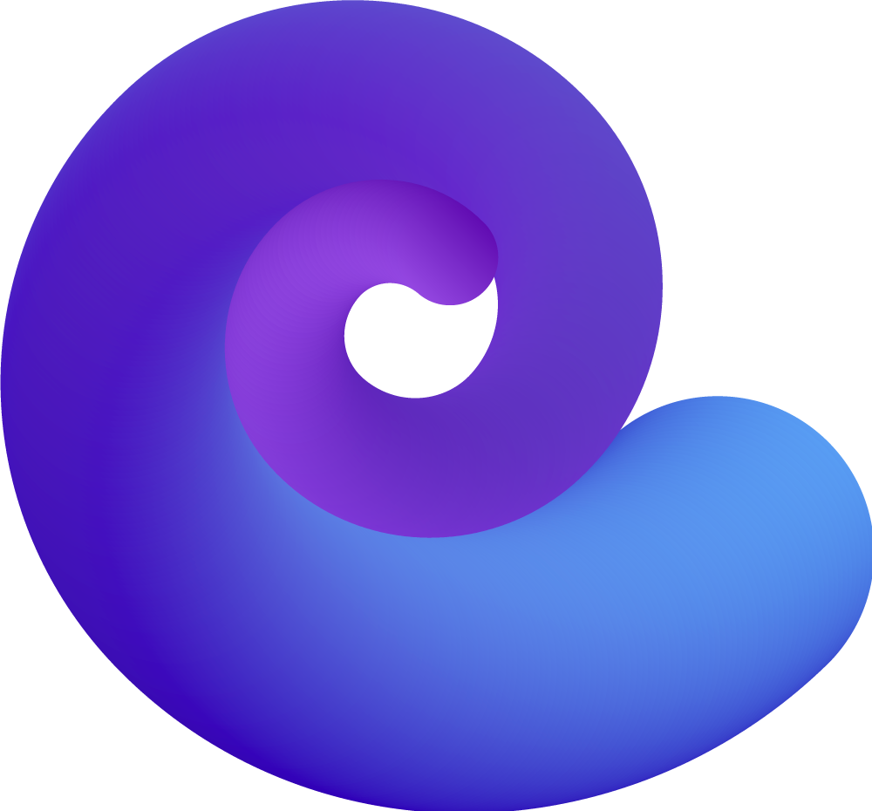
01
What is Python ?

Slide 4
What is Python ?
Python is a high-level, interpreted programming language.
Created by Guido van Rossum and first released in 1991.
Widely used across various domains.
Robust community and ecosystem.

Slide 5
02
Why Python ?

Slide 6
Why Python ?
Python has a clean and readable syntax that resembles plain English, making it an excellent choice for beginners.
It’s easy to pick up and understand, which reduces learning curve.
Python is open-source software, which means it’s freely available, and you can modify and distribute it as needed.

Slide 7
03
History of Python

Slide 8
History of Python
Python was created by Guido van Rossum in the late 1980s.
Guido van Rossum started working on Python during Christmas in 1989.
The name “Python” comes form the British comedy show “Monty Python’s Flying Circus”.
First version, Python 0.9.0 was released in February 1991.
It included features like exception handling, functions and the core data types.

Slide 9
History of Python
In 1994, Python 1.0 was released with more built-in modules and the first version of its standard library.
Python 2.0 was released in 2000, introducing list comprehensions and garbage collecion
The Python Software Foundation(PSF) was formed in 2001 to manage Python’s development.
Python 3.0 was released in December 2008 to fix design flaws and improve language consistency.

Slide 10
04
Evolution of Python

Slide 11
Evolution of Python
Python was released in 1991 and user fewer codes compared to Java, C++ and C.
It focused on code readability and developer productivity, offering features like classes with inheritance, core data types and exception handling
Python 2.x and 3.x are the most used versions, each with its own fanbase.
Major tech companies like Google, IBM and Dropbox use Python for development, scripting and software testing.

Slide 12
05
Applications of Python

Slide 13
Applications of Python
Web Development
Data Science and Analytics
Artificial Intelligence and Machine Learning
Automation and Scripting
Game Development
Scientific Computing

